Slide 1
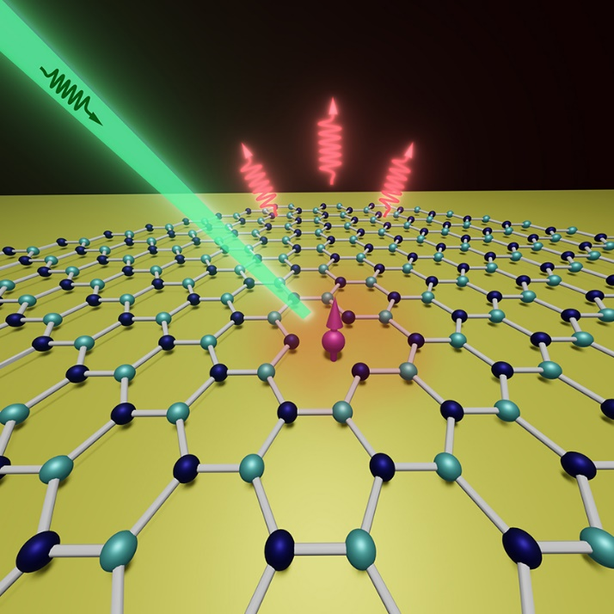

Photoluminescence Mapping of Vanadium Defects in SiC for Quantum Technology Applications
SURF 2024
Daniel Choi
Mentors:
Dr. Lijun Ma
Dr. Anouar Rahmouni
Dr. Oliver Slattery
Zhujing Xu and Tongcang Li

Slide 2
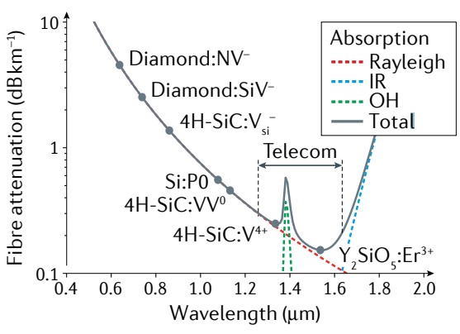
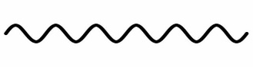
Background
Quantum Network
Quantum Key Distribution
Distributed Quantum Computing
Blind Quantum Computing
Distributed Sensing
Challenge:
Idea: Photon-mediated entanglement distribution
+
No-cloning
Theorem
|01>
|10>
Alice
Bob
G. Wolfowicz et al., Nat Rev Mater 6 (2021)
Notes:
- Blind quantum computing where a client can securely perform quantum computation on any untrusted device without disclosing information about computation being performed to the server.
-

Slide 3
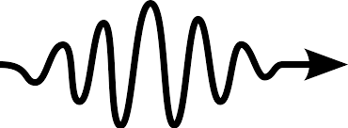
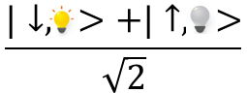
Quantum repeater
Hong-Ou-Mandel effect
Node A
Node B
Repeater
Node C
Entanglement Swapping
V defects in SiC
Simultaneity: need quantum memory
Indistinguishability: need reliable single photon source

Slide 4
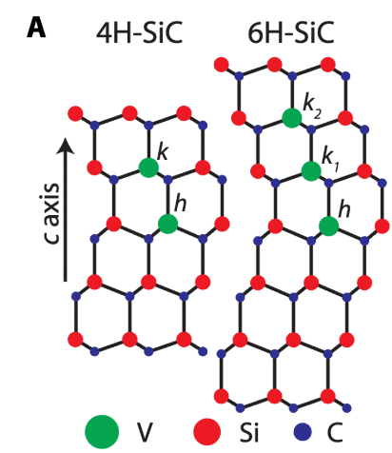
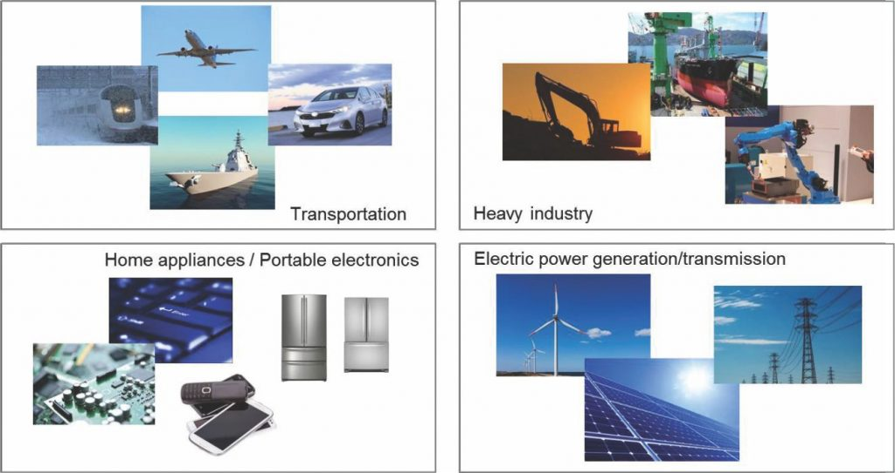
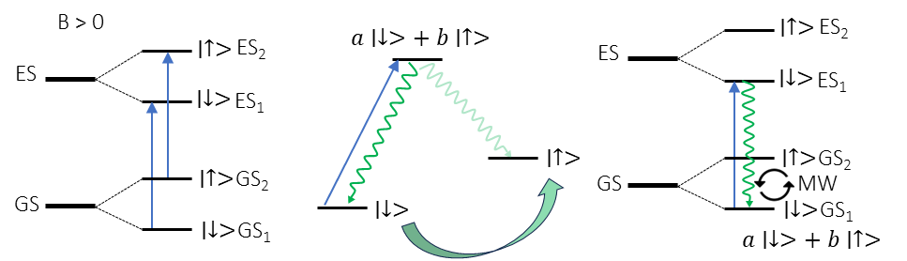

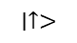
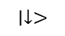
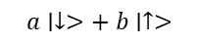
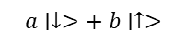
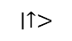
Advantages of SiC
G. Wolfowicz et al., Sci. Adv. (2020)
Power Electronics Application Overview, ELE Times Bureau
Nuclear Spin Registers
~250 polytypes
Mature growth/fabrication techniques
B > 0
$$a∣↓>+ b∣↑>$$
$$∣↑>$$
ES₂
$$∣↑>$$
ES₂
ES
ES
$$∣↓>$$
ES₁
$$∣↓>$$
ES₁
Readout
Initialization
Control
G. Wolfowicz et al., Nat Rev Mater 6 (2021)
$$∣↑>$$
$$∣↑>$$
GS₂
Telecom Emission
$$∣↑>$$
GS₂
GS
MW
GS
$$∣↓>$$
$$∣↓>$$
GS₁
$$∣↓>$$
GS₁
$$a∣↓>+ b∣↑>$$
Notes:
Although the transitions are spin conserving to the leading order, the spin orbit interaction and hyperfine interaction can cause weak mixing of the spins in excited state, allowing for spin-flip transitions to initialize the state.

Slide 5
Motivation
Given a sample of defects in SiC, can we verify that they have properties suitable for quantum network nodes?
Emission spectrum
Coherence time
Single-photon emission
High-fidelity control
Work | Wolfowicz et al. | Ahn et al. | NIST
Source | Norstel | Coherent | CMU (4H) Coherent (6H)
Implantation Energy | 190 keV | 190 keV | 500 keV 190 keV
Concentration | ~1e8/cm² | ~7e15/cm² | ~1e13/cm² ~1e8/cm²
Annealing | 1400°C | None | 1000°C
Variation in samples.
Different manufacturing methods.
Even with the same manufacturing method, some variance is inevitable.
Investigation of other polytypes.
~250 SiC Polytypes
Every polytype has different properties
Sample Comparison
Practical implementation of quantum network nodes with SiC defects requires robust characterization methods and procedures.
Notes:
Although the transitions are spin conserving to the leading order, the spin orbit interaction and hyperfine interaction can cause weak mixing of the spins in excited state, allowing for spin-flip transitions to initialize the state.

Slide 6
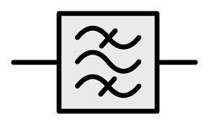
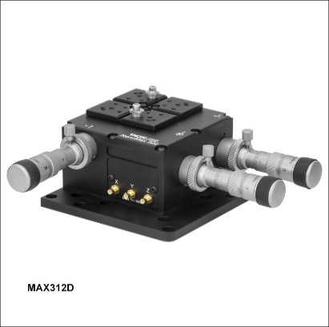
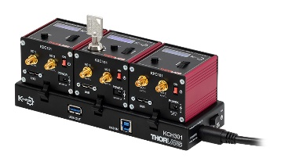

Confocal Microscope
Dichroic
Mirror
Mirror
Tunable
Filter
Nikon Objective
100x
Aspherical
Lens
UV
365nm
20μm
V-SiC Sample
SPD
3-Axis Flexure Stage
Piezo Controller
Swabian
Time Tagger
Python
Notes:
Although the transitions are spin conserving to the leading order, the spin orbit interaction and hyperfine interaction can cause weak mixing of the spins in excited state, allowing for spin-flip transitions to initialize the state.

Slide 7
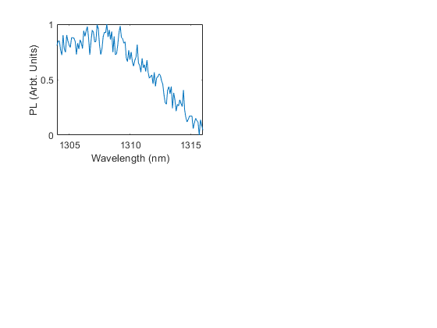
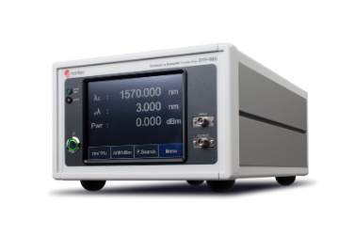
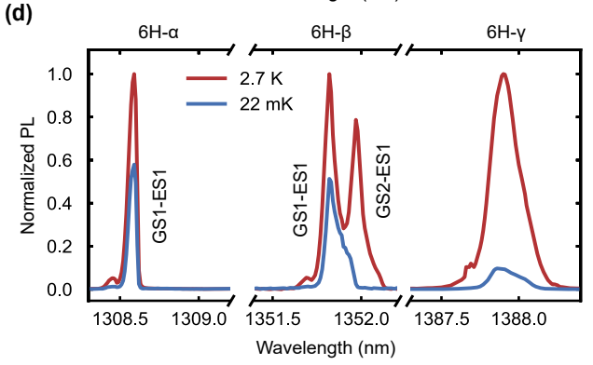
Spectroscopy
V⁴⁺ 6H-SiC Spectroscopy
Tunable Filter | Santec OTF-980
Detector | SNSPD
Range | 1304-1316 nm
Center λ Step-size | 0.1 nm
Linewidth (Δλ) | 1 nm
Integration time | 20 s
295 K
V⁴⁺ 6H-SiC Spectroscopy α Site
Despite significant doppler broadening, a peak was found around 1308.5 nm, consistent with other studies.
J. Ahn et al., arXiv:2405.16303 (2024)
Notes:
Although the transitions are spin conserving to the leading order, the spin orbit interaction and hyperfine interaction can cause weak mixing of the spins in excited state, allowing for spin-flip transitions to initialize the state.

Slide 8
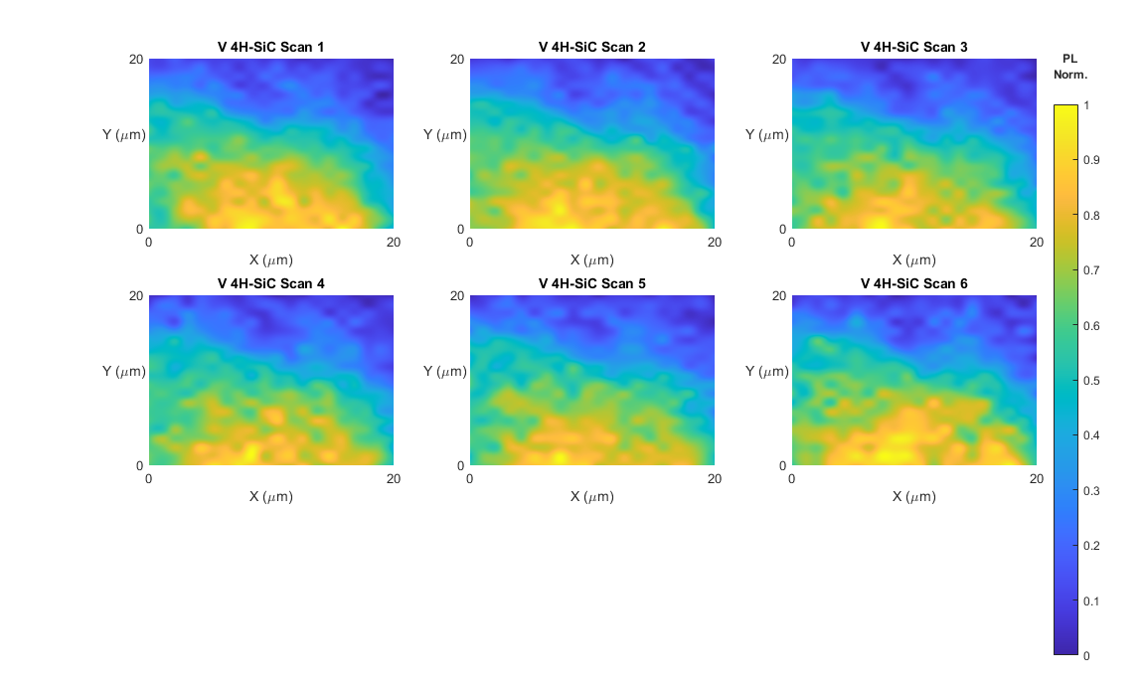
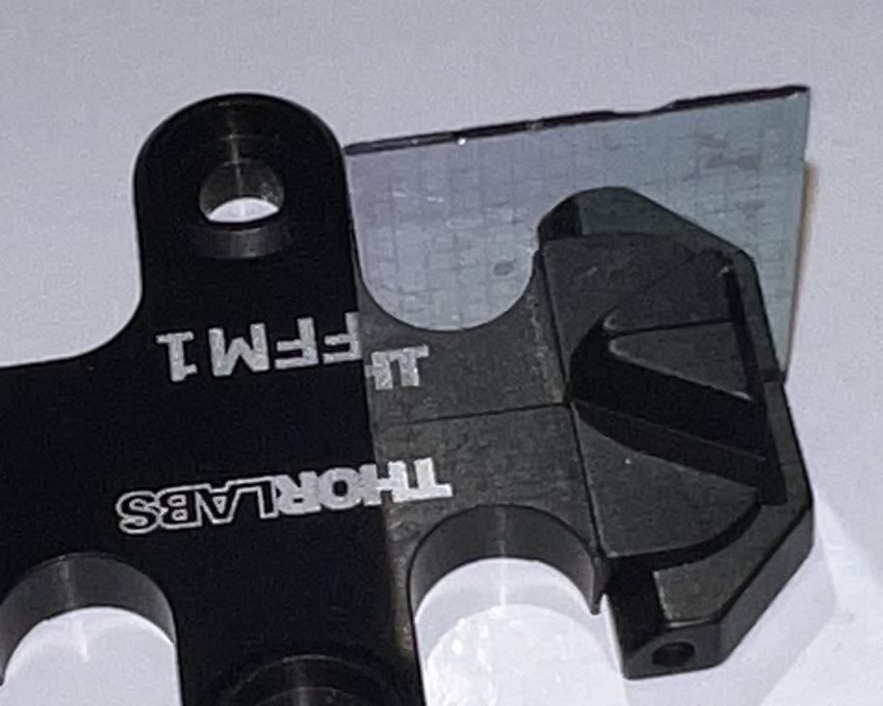
Spatial Mapping
V⁴⁺ H-SiC PL Mapping
Stage | Thorlabs MAX311D
Controller | Thorlabs KPZ101
Detector | InGaAs/InP SPD
Area | 20μm x 20μm
Increment | 1.05μm (3.94V)
Integration time | 5 s
V⁴⁺ 4H-SiC Non-resonant PL Mapping
Higher concentration was found at the centerline (Y=0) as expected based on implantation method.
While a certain degree of repeatability was achieved, higher resolution is required for a more accurate mapping. Future improvement:
Closed-loop system to avoid hysteresis.
Cryogenic condition to remove thermal noise and doppler broadening.
4H-SiC Sample on a Mount
Notes:
Although the transitions are spin conserving to the leading order, the spin orbit interaction and hyperfine interaction can cause weak mixing of the spins in excited state, allowing for spin-flip transitions to initialize the state.

Slide 9
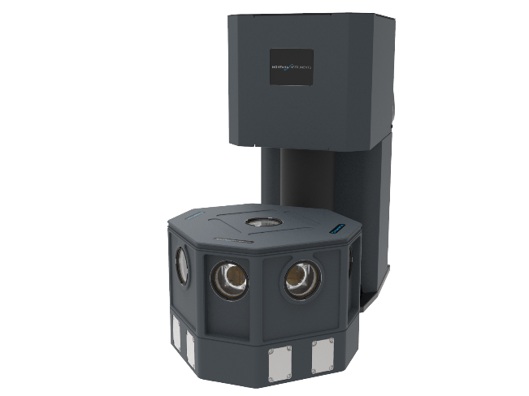
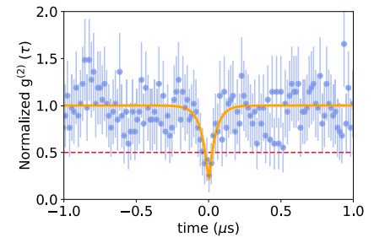
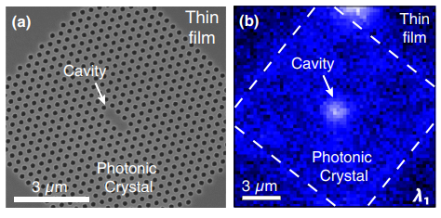
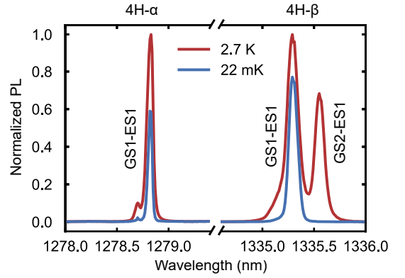
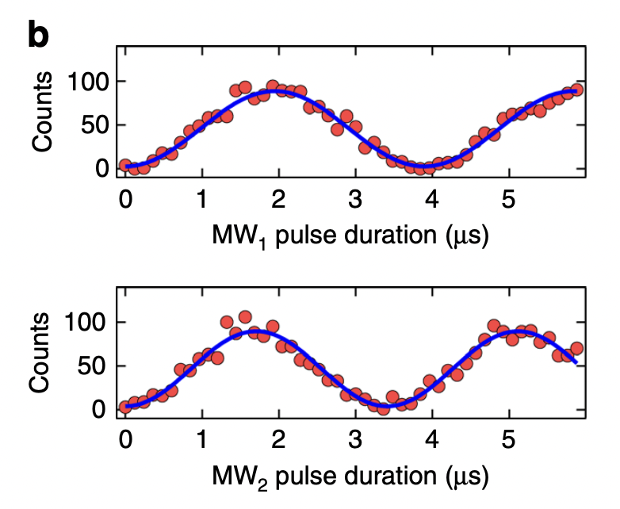
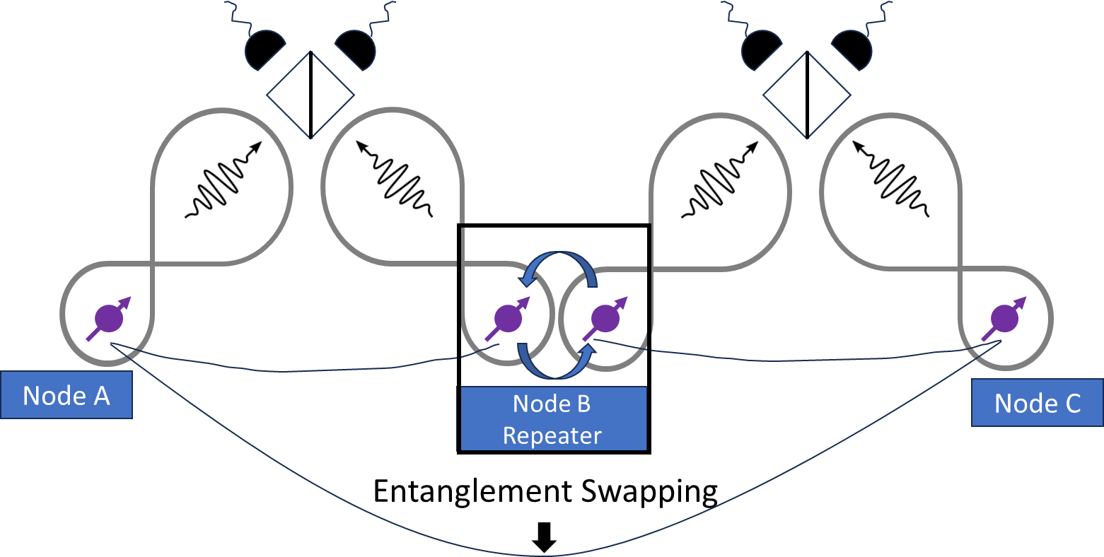
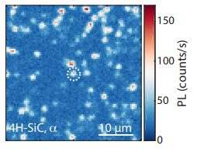
Future Work
Montana Instruments
Cryogenic condition
P. Cilibrizzi et al., Nat Commun 14 (2023)
Single-photon emission
G. Calusine et al., Phys. Rev. Applied 6 (2016)
Integration in photonic crystal cavities
J. Ahn et al., arXiv:2405.16303 (2024)
Spectroscopy of other polytypes and sites
R. Nagy et al., Nat Commun 14 (2019)
Coherent spin control
Relaxation and coherence time
Doping concentration
Charge stability
Isotopic composition
Narrow inhomogeneous distribution
Strain tuning
Coherence time
Experimental Demonstration
G. Wolfowicz et al., Sic. Adv. 6 (2020)
Spatial PL mapping at resonant frequencies
Notes:
Although the transitions are spin conserving to the leading order, the spin orbit interaction and hyperfine interaction can cause weak mixing of the spins in excited state, allowing for spin-flip transitions to initialize the state.

Slide 10
Conclusion
Set up the experiment to characterize V⁴⁺ defects in SiC
Spectroscopy was consistent with other studies.
PL Mapping confirmed expected doping concetration gradient.
A certain degree of repeatability was achieved.
This work will
enable characterization of V⁴⁺ defects in other polytypes
enable further investigation to validate the potential of V⁴⁺ SiC for quantum application.
Notes:
Although the transitions are spin conserving to the leading order, the spin orbit interaction and hyperfine interaction can cause weak mixing of the spins in excited state, allowing for spin-flip transitions to initialize the state.

